Slide 1
Design Pad
A project by Jacob Bird

Slide 2
What is it?
This project will produce a drawing program like illustrator.
It will draw ovals, circles, rectangles, squares and lines.
It will also have a pen tool for drawing curves and curved shapes.

Slide 3
Who is the program for?
This program is for designers who want a simple draw program.
Web designers can use it to create art for their web pages.
Print designers can use it to create flyers, black and white news paper pictures and black and white magazine art.

Slide 4
What makes this application different?
The difference between this product and other products is simplicity and ease of use.
Other 2-Dimentional draw programs are overly complex and require a knowledge of the program to achieve even the most simple tasks.

Slide 5
Importance to the end user
It is important to the end user to have a draw program that can save a file that can be opened for later use.
Having the ability to move shapes around is also important.
The ability to create in the 2-Dimensional environment is important to the end user.

Slide 6
How will this be made?
This will be written in Java using JavaFx.
The file save system will save to an memento and will be auto-saved.
The pen tool will use Bezier curves for the drawing of the curves(to be explained later).

Slide 7
Requirements
Easy to use
Intuitive
Draws all of the shapes
Draws a custom shape
Edit functions
File functions
View functions
Help functions
The rest of the use cases are found in the requirements document. Please follow the link below.
https://docs.google.com/document/d/1I_nOSMrHvsuu8arZDx8oF2Z9mjtt19JmBrhbf1D1Tj4/edit?usp=sharing

Slide 8
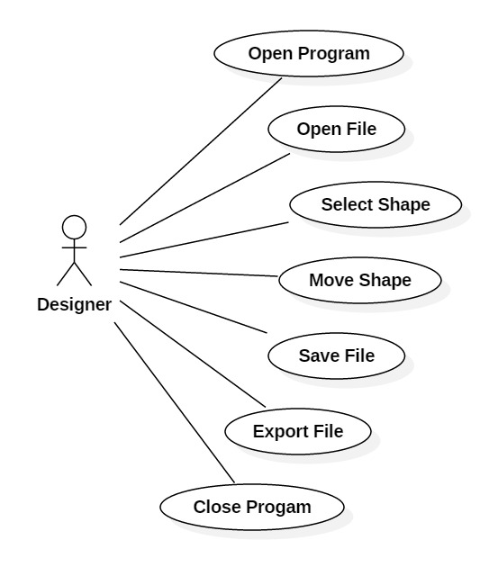
Use Case Sample

Slide 9
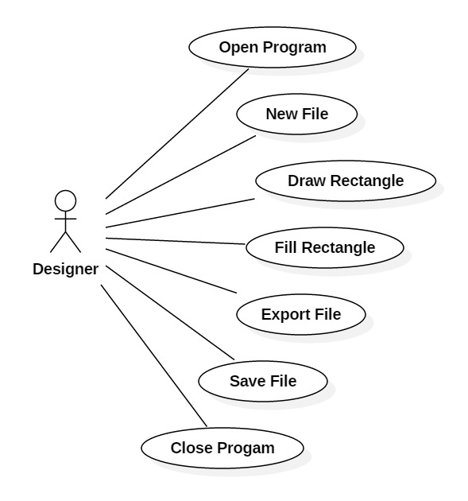
Use Case Sample 2

Slide 10
Buttons
There will be one button for each draw tool.
In addition to the one button for each draw tool there will be a select button with the image of a mouse pointer.
The select button will choose a select tool which allows the user to move the shapes around.
Includes an undo button.

Slide 11
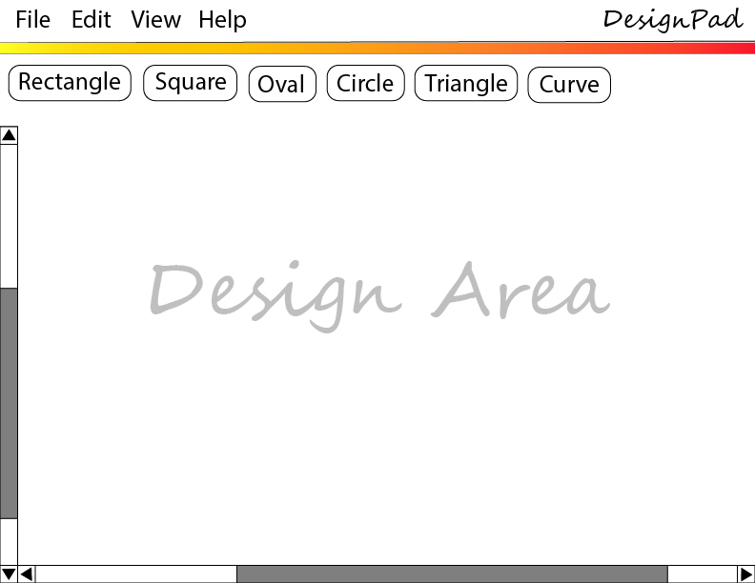
Graphical User Interface

Slide 12
Shapes
Ovals will resize with a box around it and handles at the corners.
Circles will also resize
Rectangles like ovals resize before getting saved.
Squares are the same as rectangles only with equal length sides

Slide 13
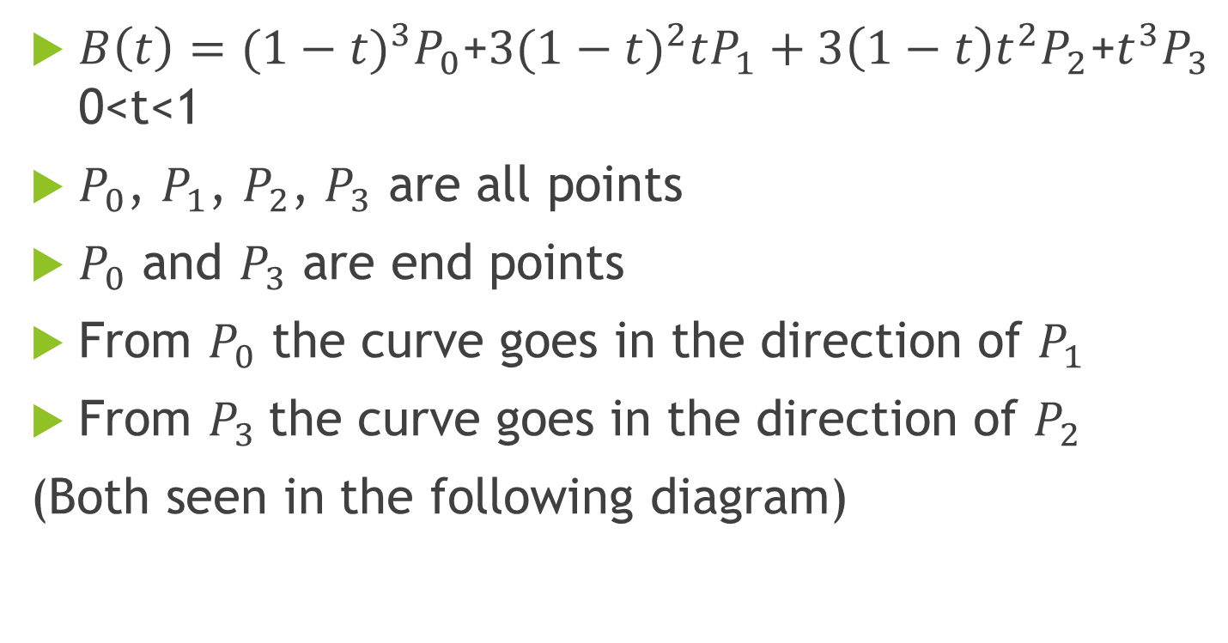
Bezier Curves (Cubic)
$B\left(t\right)={(1−t)}^{3}P_{0}$+${3(1−t)}^{2}tP_{1}+3\left(1−t\right)t^{2}P_{2}$+$t^{3}P_{3}$ 0<t<1
$P_{0}$, $P_{1}$, $P_{2}$, $P_{3}$ are all points
$P_{0}$ and $P_{3}$ are end points
From $P_{0}$ the curve goes in the direction of $P_{1}$
From $P_{3}$the curve goes in the direction of $P_{2}$
(Both seen in the following diagram)

Slide 14




Pen tool – step 1
The pen tool draws curves.
$$P_{1}$$
$$P_{2}$$
$$P_{3}$$
$$P_{0}$$

Slide 15
Pen tool – Step 2
Connect curves

Slide 16
Pen tool – Step 3
Creating pen tool objects

Slide 17
Export to file – The user will be able to export their drawing to a file
The Snapshot JavaFX Tool allows a pane to be exported to a file format
Supported file formats include
Png
Gif
Jpg
Jps
Mpo
Tiff

Slide 18
Design Doc. – Classes and Interfaces
Shapes Interface
Shapes Themselves
Shape Factory
Design Class
GUI Class
Design Memento
Undo/Redo
Save
Export
https://docs.google.com/document/d/1PzH1pD6_k0qODFjtJGq-wS-vkVK1ryhL6lj4_5qjJMo/edit?usp=sharing

Slide 19
Design Document
Design Patterns
A Factory is used to deliver the shapes to the design class
A Memento is used to save the state of the design at any one time.
A Facade is used to remove GUI code from the main class

Slide 20
The Schedule
A Trello board is used to keep the schedule.
Each task is 4-5 days long estimated time.
Predicted over-time for certain tasks is included in the Trello board.
Predicted time for unforeseen problems is also included in the Trello board.
All tasks have an end date
https://trello.com/b/ub7L9a9p/design-pad

Slide 21
GIT Hub
All of the documents created for this project can be accessed through GIT Hub.
Presentation
Design Document
Requirements Document
https://github.com/jacobbird/DesignPad

Slide 22
The Idea is expandable
Many additional features may be added if time allows.
Line color
Fill color
Gradients
Filling custom shapes with color
Rotation
Resize

